Slide 1

Kings Fleet
Connecting : Encouraging : Supporting

Slide 2
What is Kings Fleet?
King’s Fleet is a global gathering of Evangelical Christian individuals and mission organisations who are passionate about using boats and ships, of all shapes and sizes, as ministry tools to share the Good News of Jesus Christ.
Our vision is to list, connect and encourage EVERY Christian Boat Ministry in the world.

Slide 3
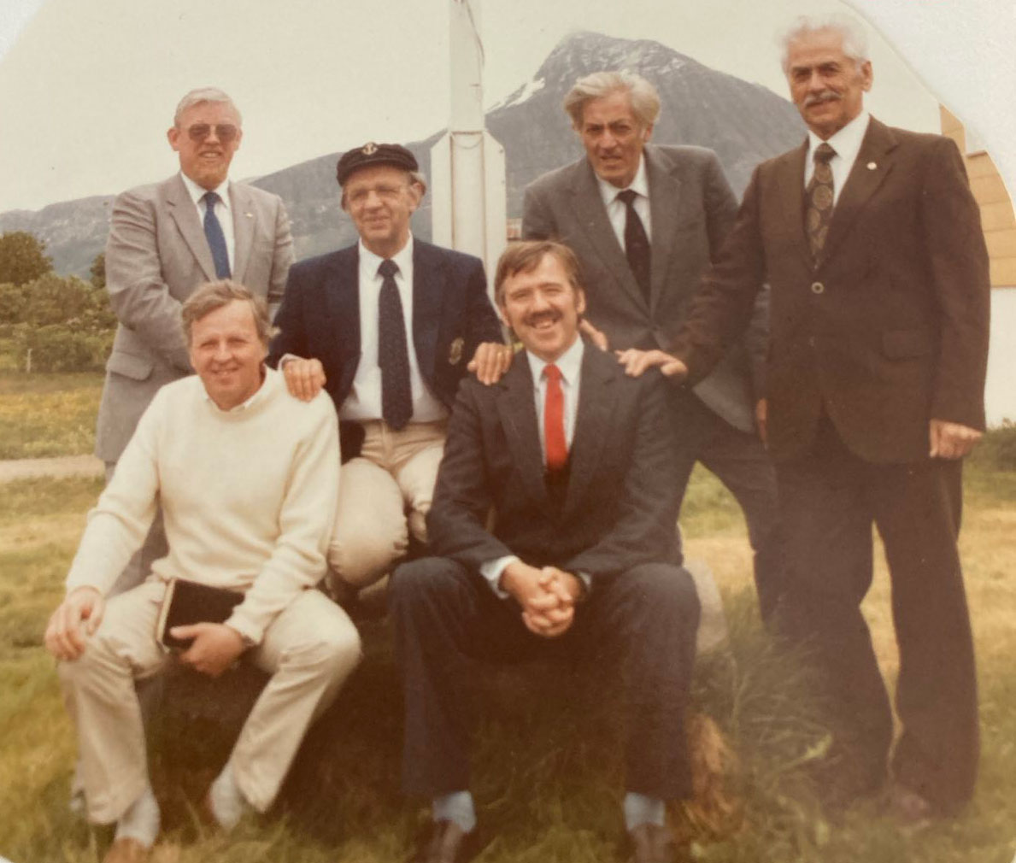
Kings Fleet History
Kings Fleet started in Sweden in 1979, it was a group of skippers from maritime ministries in Sweden and throughout Northern Europe who met together annually.

Slide 4
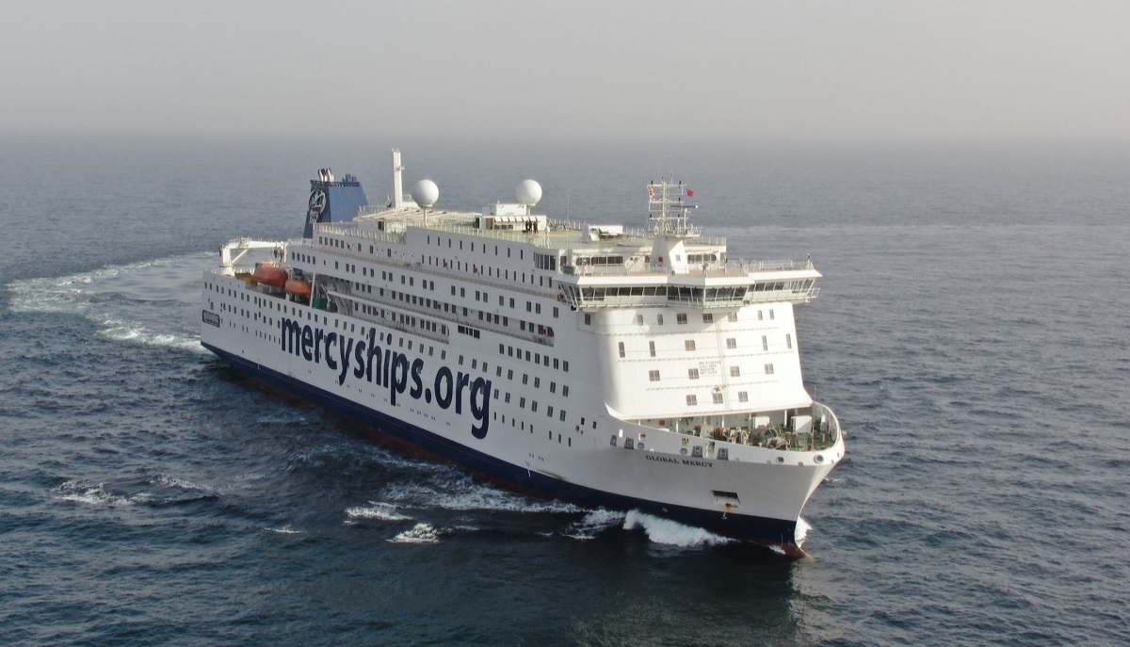
What is a Maritime Ministry?

Slide 5
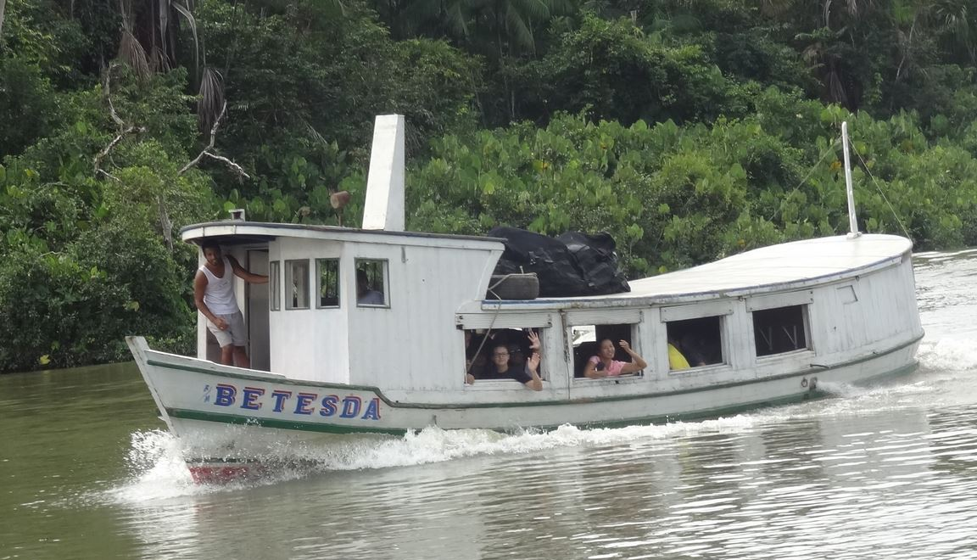
What is a Maritime Ministry?

Slide 6

What is a Maritime Ministry?

Slide 7

What is a Maritime Ministry?

Slide 8
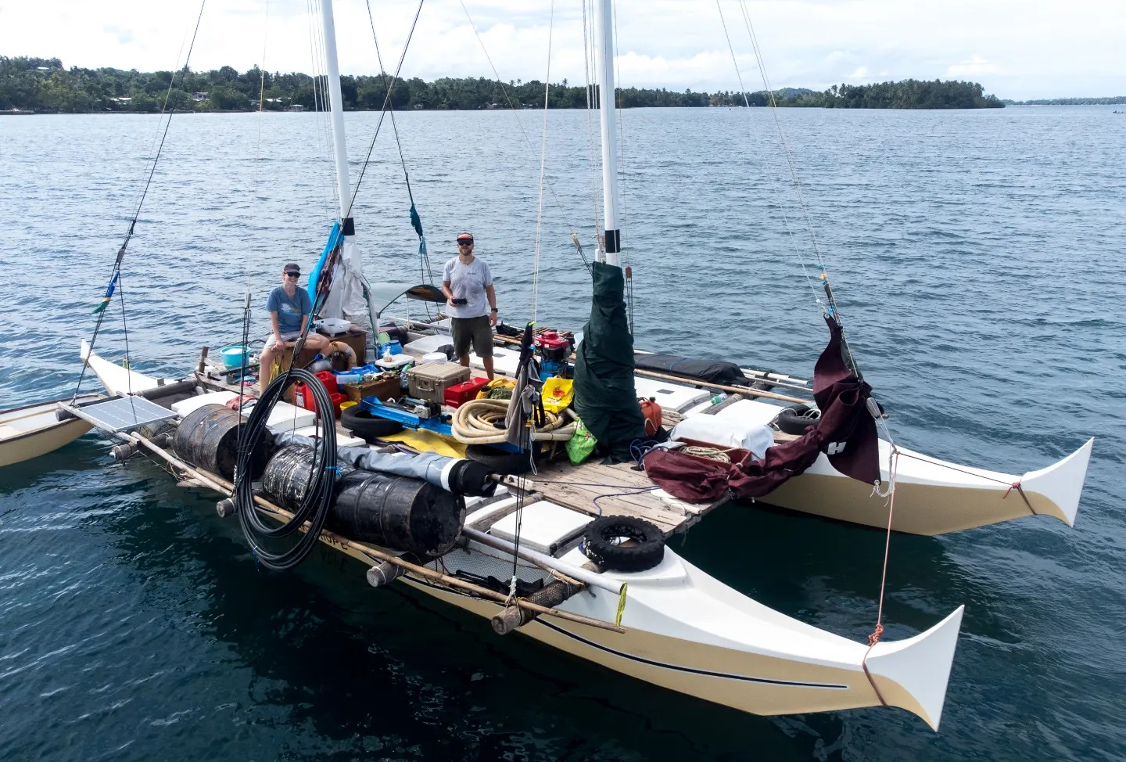
What is a Maritime Ministry?

Slide 9
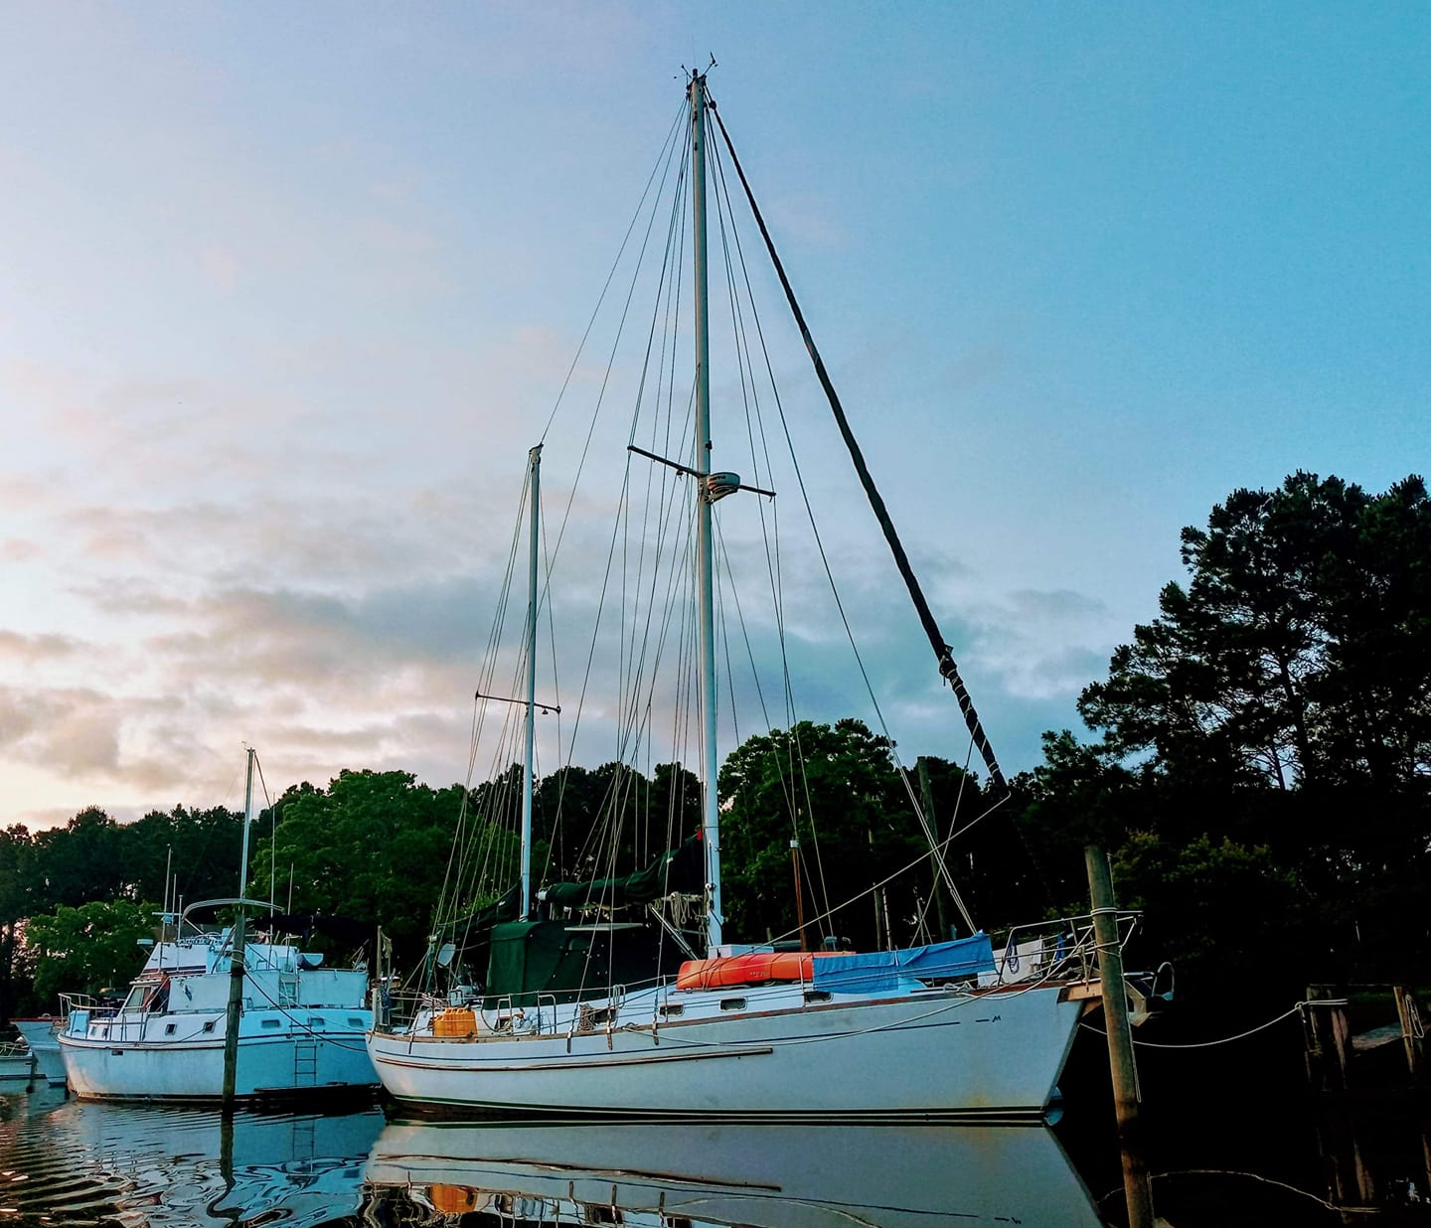
What is a Maritime Ministry?

Slide 10

What is a Maritime Ministry?

Slide 11
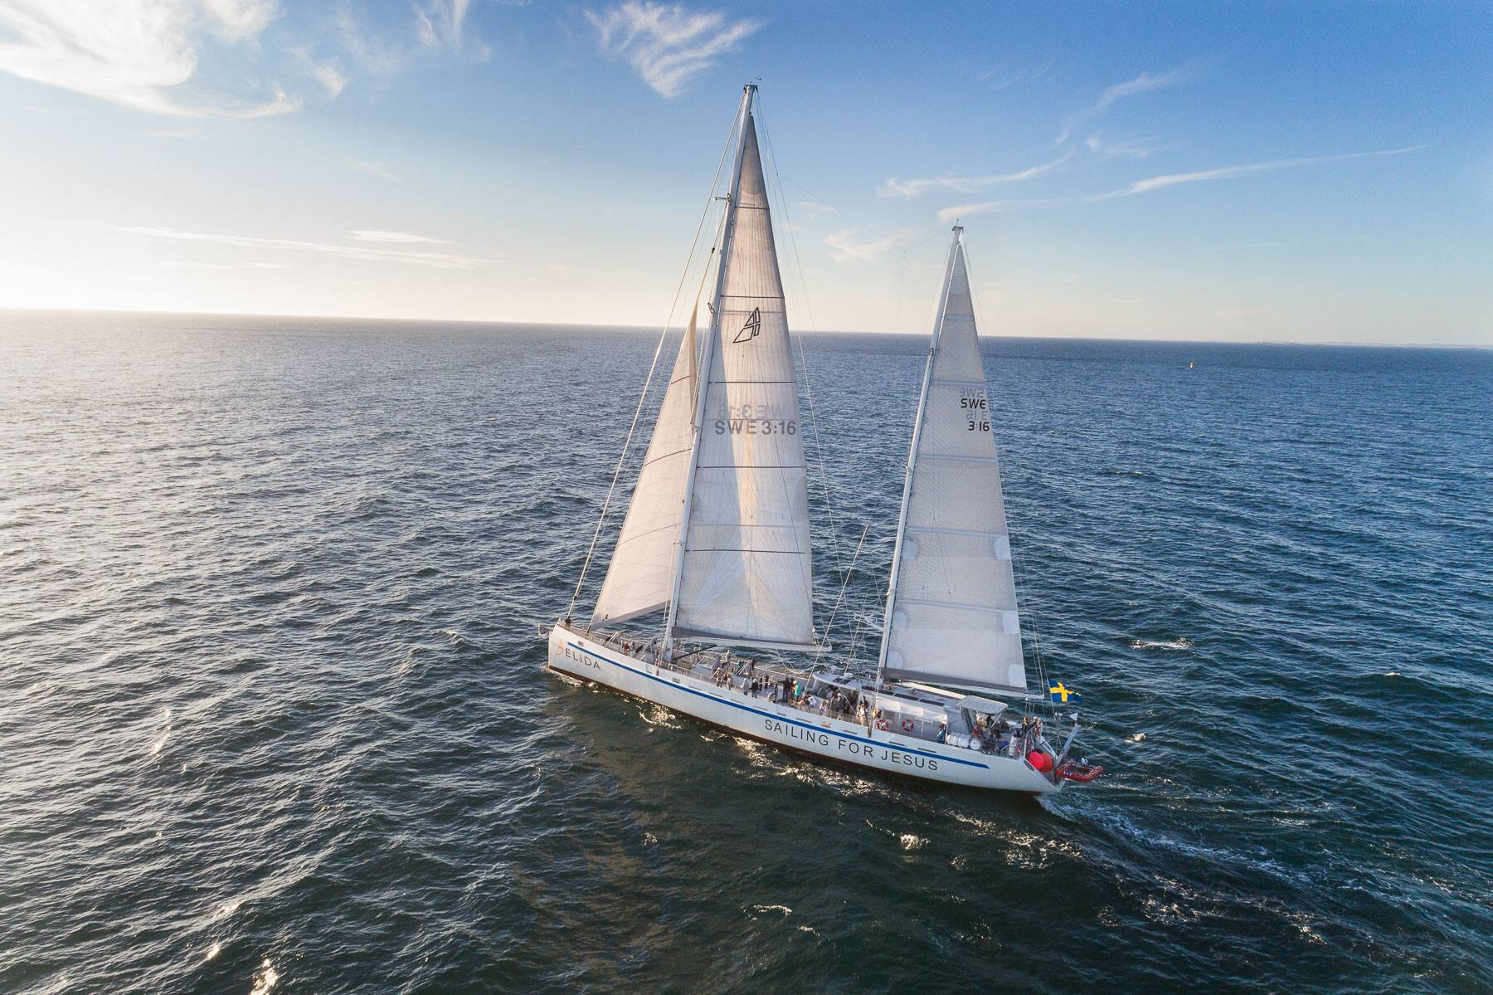
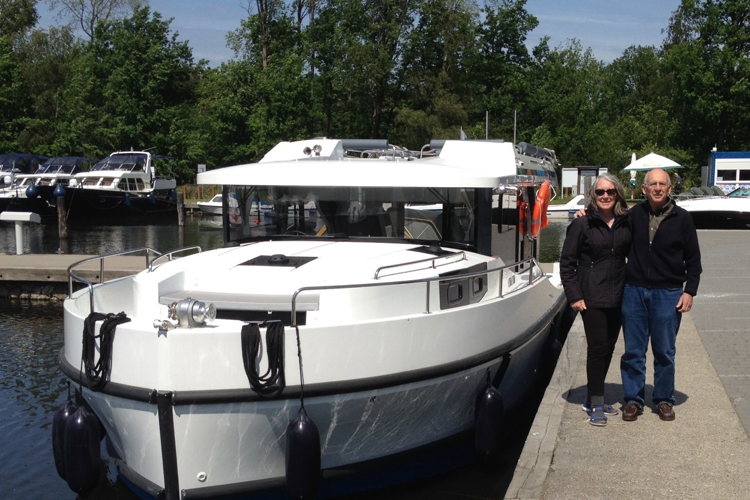
What is a Maritime Ministry?

Slide 12
Kings Fleet Today
Today we have 111 ministries listed (with 182 vessels) more in the pipeline!
We have held over 50 online Fika’s connecting and supporting members.
145 members in our online Crews Mess Community.
Almost 500 people on the mailing list.

Slide 13
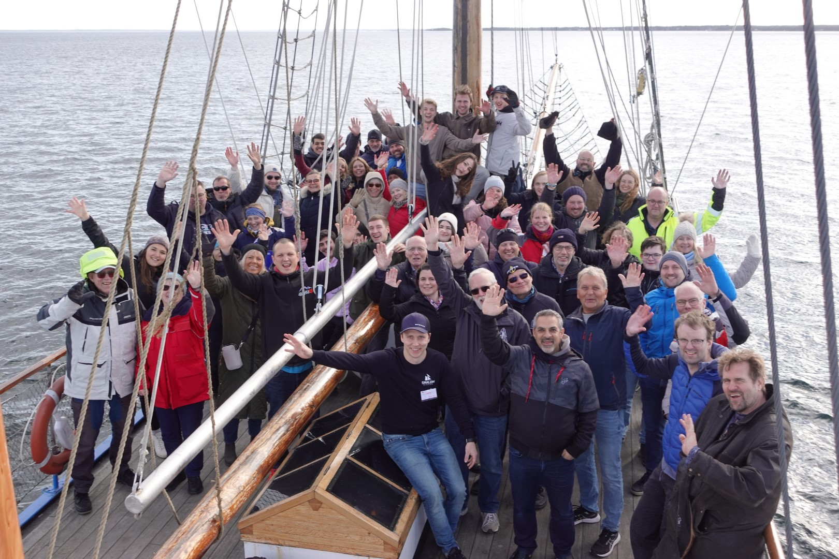

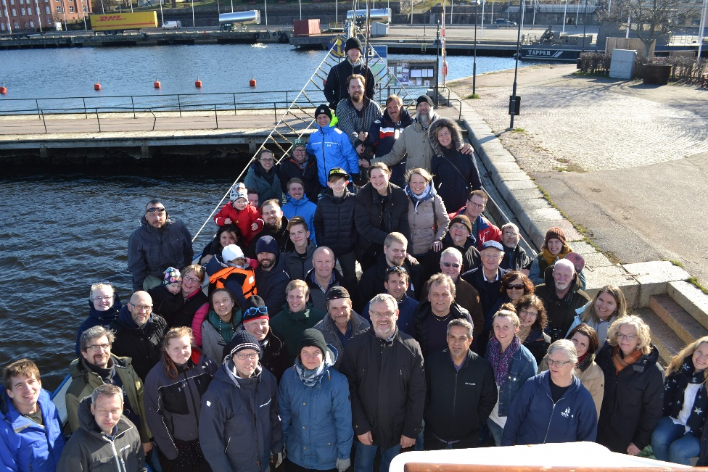
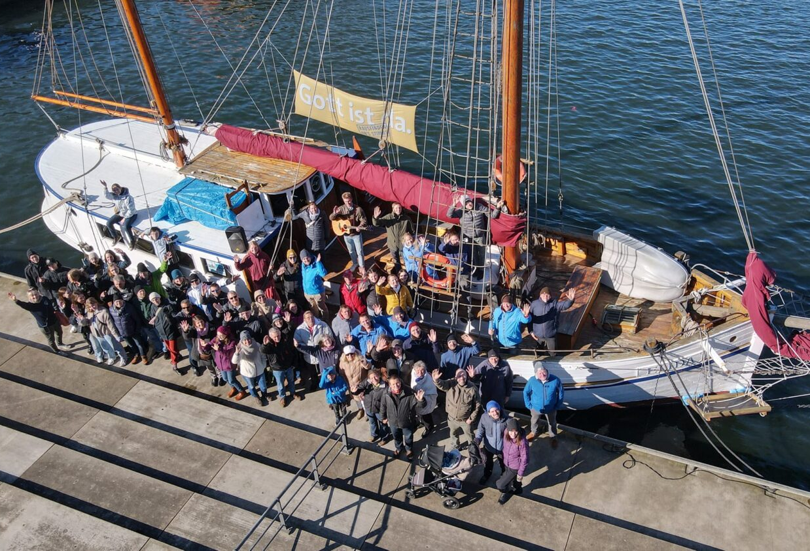
Annual Conferences

Slide 14

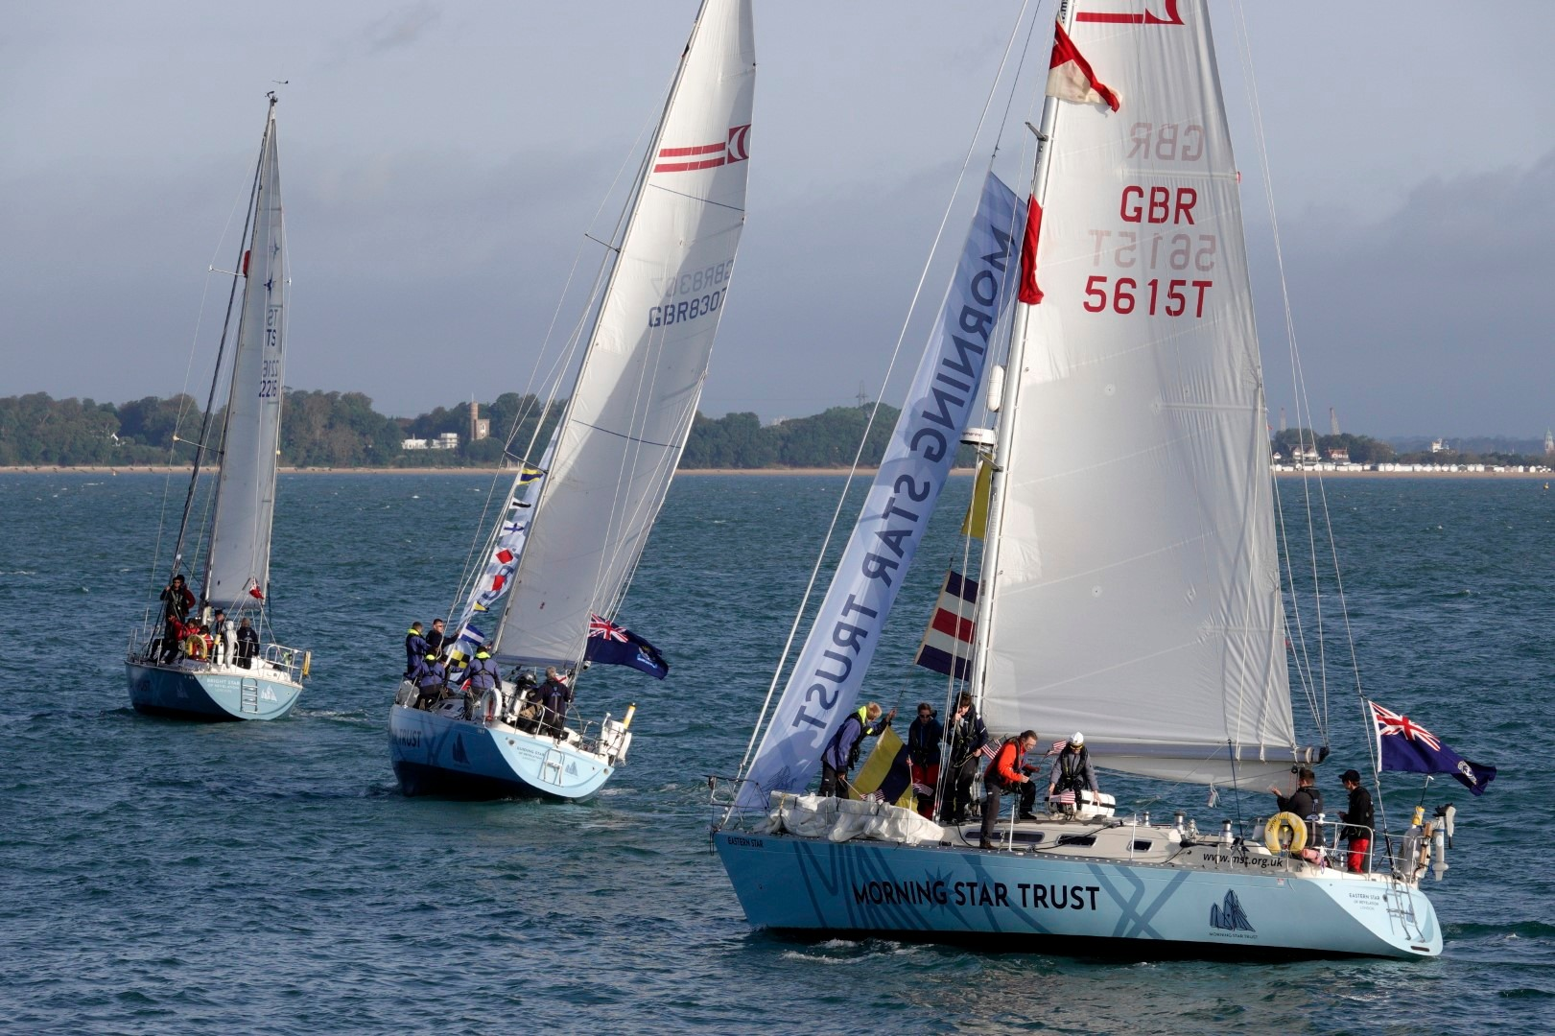



Passage Planning 2025

Slide 15
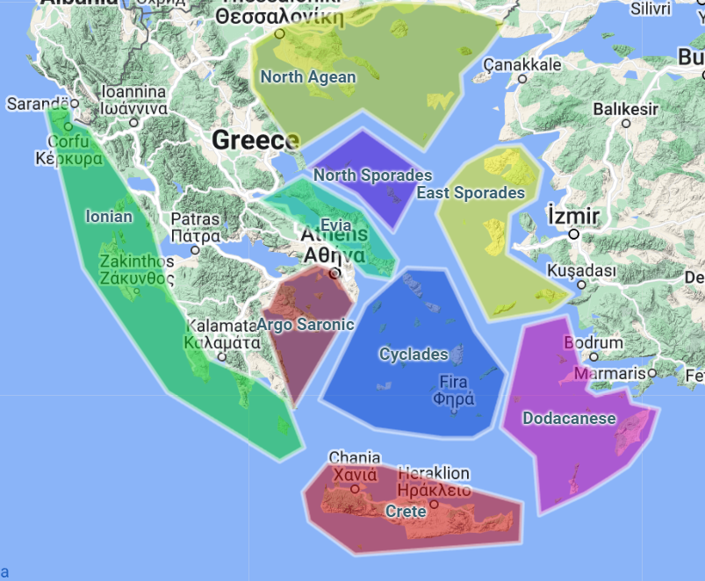
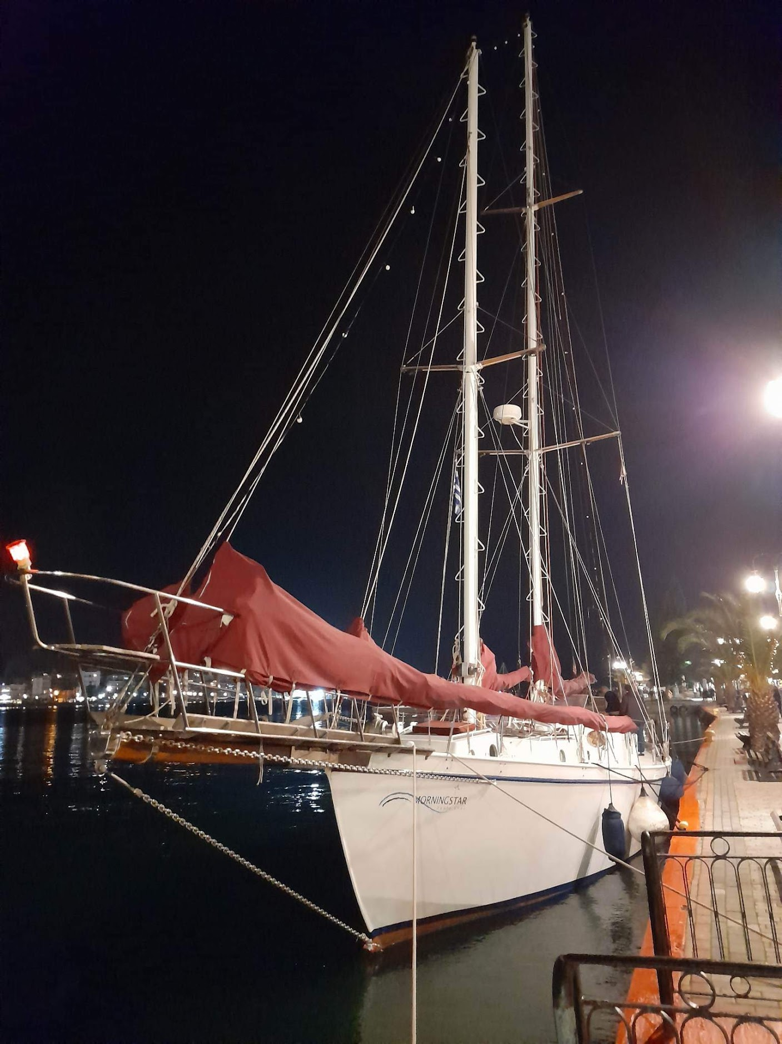




Picking up where Paul left off…

Slide 16
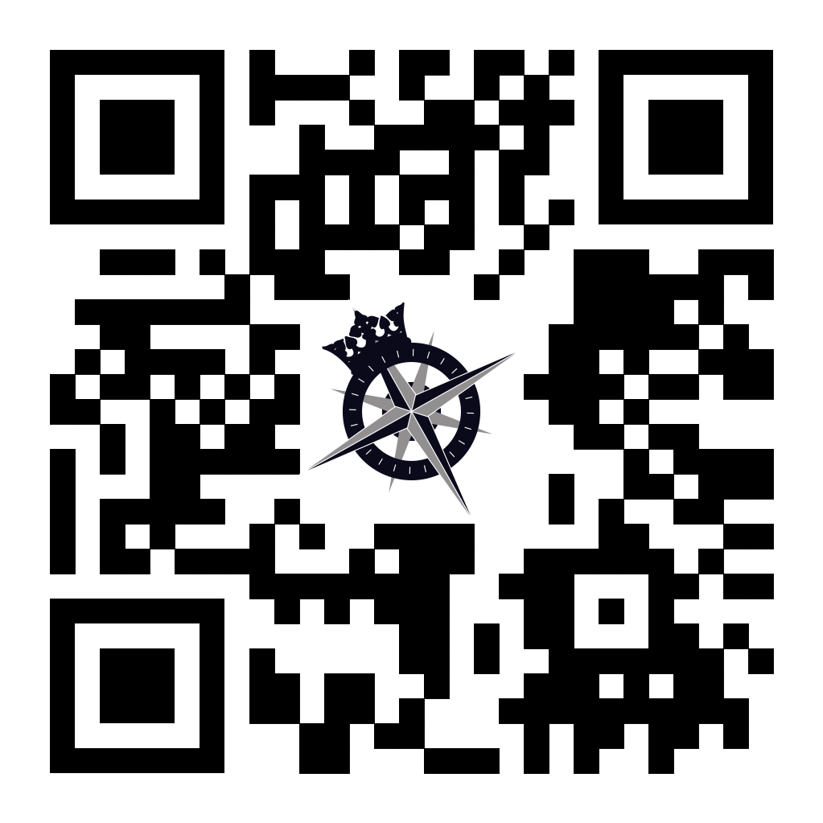
Connect with us today!
www.KingsFleet.org
www.BroadReachMaritime.org

